Slide 1
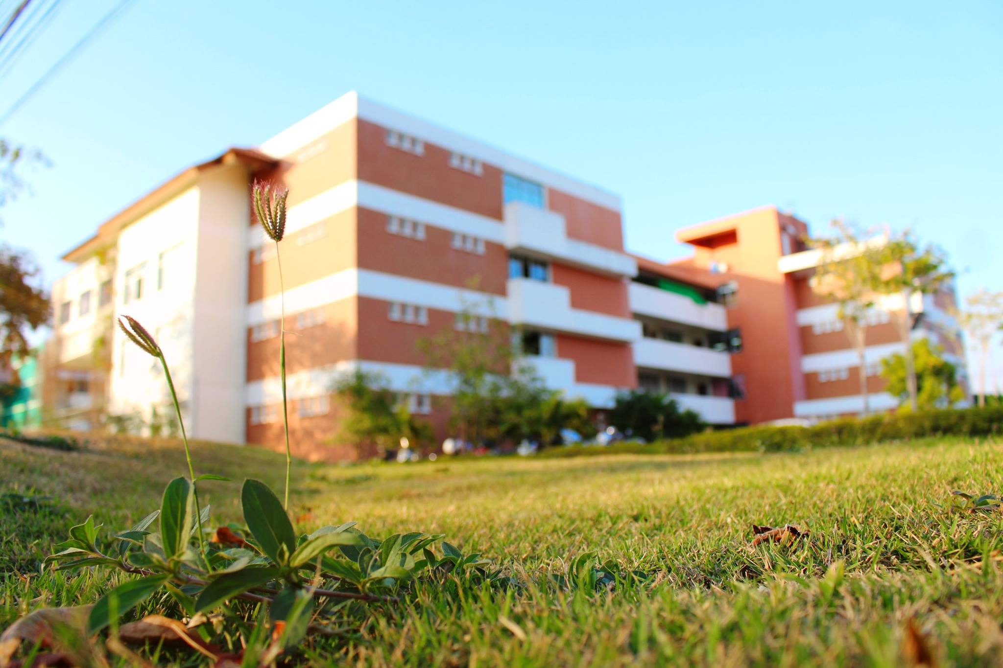
Welcome Dr. David Blake and participants to the special talk on “The History and Politics of Water Resources Development in Northeast Thailand: Some Reflections” at the Faculty of Environment and Resource Studies, Mahasarakham University February 10th, 2016

Slide 2
Agenda
9.00 to 9.30 am Registration
9.30 to 9.45 am Welcome speech by Asist. Prof. Dr. Yanyong Inmuong, the Dean of the Faculty of Environment and Resource Studies, Mahasarakham University
9.45 -11.30 am Special Talk on “The history and politics of water resources development in Northeast Thailand” by Dr. David Blake
11.30 am-12.00 pm Question and Answer session

